Slide 1
Compressing DNN and Shallow vs Deep
Corneliu Florea
Computer Vision Reading Group at IMAR

Slide 2
Why?
“The quality is so high so the cost/resources won’t matter” … never happens
Typically the customers bargain for less cost. More often is about resources needed than about money
Thus : resources are critical
Funny stuff: in academia is happening also but it is less visible

Slide 3
General Notes
Large model
Reference
Trainer
Teacher
Mimicking
Sufficient performance
High computational cost
memory
run time
training time
Smaller model
Trainee
Student
Mimic model
Aims for comparative performance
Has computational cost constrains

Slide 4
Model Compression
Bucila & Caruana & Niculescu-Mizil “ Model Compression” – KDD 2006
Idea:
Ensemble methods are the most powerful classifiers
Ex: bagging [2], boosting[14], random forests[3], Bayesian averaging [9] and stacking [17]
(Hinton, 2015): Almost every challenge is won by an ensemble
Ensemble takes a lot of resources to store and run
“Compress the function that is learned by a complex model in to a much smaller, faster model that has comparable performance”. Learn to mimic
Why: “neural nets are universal approximators: given enough training data, and a large enough hidden layer, a neural net can approximate any function to arbitrary precision”
Bucila et al.“ Model Compression”

Slide 5
How
Procedure:
Use the Ensemble (Teacher) to label a large enough data set
Train the mimic model (student) using the teacher labeled data
Result:
a neural net that makes predictions similar to the ensemble, and which performs much better than a neural net trained on the original training set.
The critical point – get enough data
Bucila et al.“ Model Compression”

Slide 6
Get Enough Data!
If possible collect unlabelled data
For images the solution is straight-forward
Otherwise generate synthetic data:
The synthetic distribution should be very similar to the true distribution
Alternatives:
Random
NBE
MUNGE (their proposal)
Bucila et al.“ Model Compression”

Slide 7
Random and NBE
Random:
Generate data for each attribute independently
Compute the marginal distribution from the true data
Ensure that the random data follows the marginal distribution
Conditional structure is lost
NBE – Naïve Bayes estimator
Use NBE to get the joint distribution of the data
Get random samples according to the joint
Probably is hard to get accuracy
Bucila et al.“ Model Compression”

Slide 8
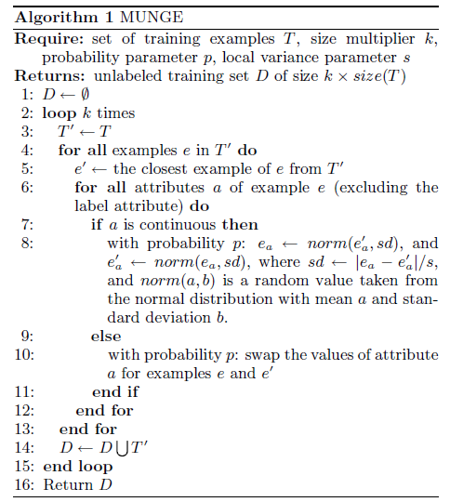
MUNGE
Linear interpolation on a randomized grid between closest neighbors from the training set.
Bucila et al.“ Model Compression”

Slide 9
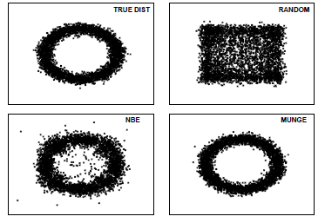
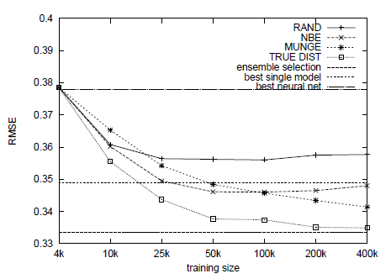
Results
Bucila et al.“ Model Compression”

Slide 10
Going to Deep networks
Ba & Caruana “Do Deep Nets Really Need to be Deep?” NIPS 2014
Claim : shallow nets can learn models with the same accuracy as deep networks!
Results show that:
Shallow can learn if they have much more parameters
Even so they are much faster to train
Given the same memory footprint: deep and with convolutions is better [Urban et al. 2017]
Ba & Caruana.“ Do Nets be deep”

Slide 11
Procedure
Steps:
Train a state-of-the-art deep model – “Teacher”
Train a shallow model to mimic the deep model – “Student”
How:
Use, other, very large datasets
Why (it should work):
It learns the function of the accurate model
Ba & Caruana.“ Do Nets be deep”

Slide 12


Training
Instead of being trained with cross-entropy on the p values where
output by the softmax layer from the deep model, are
Do train directly on the log probability values z, also called logits, before the softmax activation
Loss:
W - weight matrix between input features x and hidden layer, β - weights from hidden to output
g(x(t);W; ) = f(Wx(t)) -model prediction on the training data point
f() is the non-linear activation of the hidden units
Ba & Caruana.“ Do Nets be deep”

Slide 13

Speed-up
Adding a bottleneck linear layer with k linear hidden units between the input and the non-linear hidden layer sped up learning dramatically
W = UV
U and V can be learnt by back-propagating through the linear layer
Ba & Caruana.“ Do Nets be deep”

Slide 14
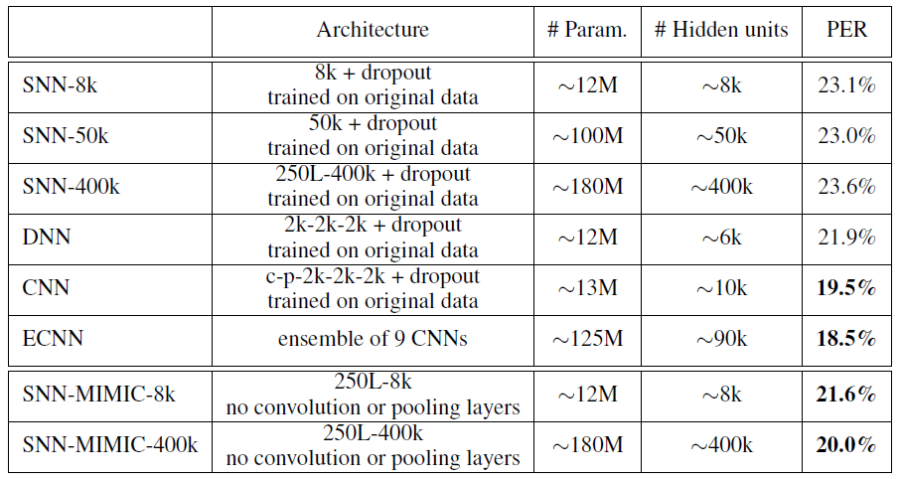
Experiment on TIMIT
DNN = 3 fully connected hidden layers with 2000 (ReLU)
CNN = 1 conv layer + 1 max-pool layer + 3 hid 2000 ReLU units
ECNN = ensemble 9 CNN
Unlabelled data = trained data without labels
phone error rate (PER)

Slide 15
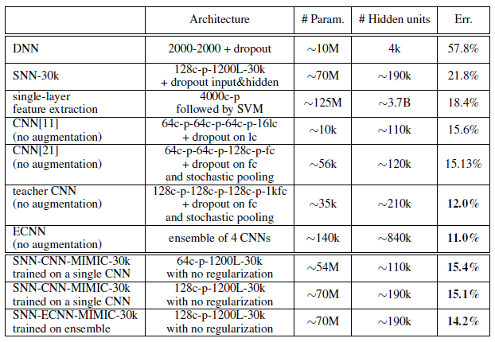
Experiment on CIFAR-10
Unlabelled data – 1milion taken 80M tiny images

Slide 16
Why mimicking is better than scratch
Potential wrong annotation are eliminated
Hard to learn regions may be described by softer ways by the teacher
Learning hard labels is more difficult that soft probabilities
In the training set there may exist impossible associations data-label. The student sees only possible associations.
Ba & Caruana.“ Do Nets be deep”

Slide 17
Redoing in 2016
Urban et al. “Do deep conv nets really need to be deep and conv?” submitted to ICLR 2017
Experiments on CIFAR 10
Shallow nets has the same number of params as deep ones
Aims for state of the art precision
Data augmentation
Bayesian optimization for best params

Slide 18
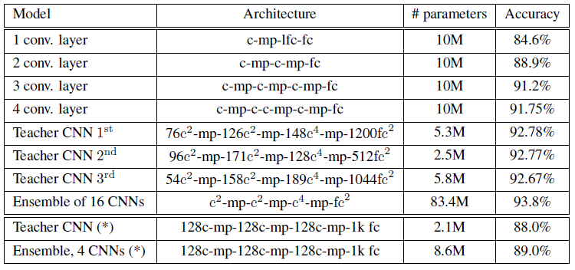
Results

Slide 19
Dark knowledge and distillation
Hinton: “ I invented the term "Dark Knowledge". Its inspired by the idea that most of the knowledge is in the ratios of tiny probabilities that have virtually no influence on the cost function used for training or on the test performance. So the normal things we look at miss out on most of the knowledge, just like physicists miss out on most of the matter and energy.”
https://www.reddit.com/r/MachineLearning/comments/2lmo0l/ama_geoffrey_hinton/
Same principle as in the works of Caruana:
Learn a student from teacher functionality and impose that the student be smaller

Slide 20
Procedure
Use the class probabilities produced by the Teacher as “soft targets” for training the small model
“softmax” output layer that converts the logit, z_{i}, computed for each class into a probability, q_{i}, by comparing z_{i} with the other logits
higher value for temperature T produces a softer probability distribution over classes

Slide 21
Results MNIST
Large neural net (teacher):
two hidden layers with 1200 rectified linear hidden units
Heavy regularization
Training on 60000 images
67 test errors
Small net
two hidden layers of 800 rectified linear hidden units
No regularization -146 errors
Regularization by matching the soft targets of the teacher - 74 test errors
The best temperature depends on the small net architecture

Slide 22
Results – Speech ASR
Baseline architecture: 8 hidden layers each containing 2560 rectified linear units and a final softmax layer with 14,000 labels
Training : 2000 hours of spoken English data
Student – equal with baseline

Slide 23
Results- JFT
JFT database (Google internal db): 100 million labeled images with 15,000 labels
Ensemble: one generalist and many specialists
Specialist focus on confusing classes?
NOT quite understandable !!!!

Slide 24
Dark knowledge
Much of the knowledge passed from the teacher to the student is conveyed as dark knowledge contained in the relative scores (probabilities) of outputs corresponding to other classes, as opposed to the scores given to just the output for the one correct class
Distillation allows smaller and/or shallower models to be trained nearly as accurate as the larger, deeper models they mimic. Yet these same small models are not as accurate when trained on the 1-hot hard targets in the original training set.
The reason for this is not yet well understood.

Slide 25
Applications
Krafka et al. “Eye Tracking for Everyone” – CVPR 2016
Teacher: AlexNet (similar) trained end-2-end
Student: imgs 80x80 0.05sec /iPhone 6s
Espresso (http://codinfox.github.io/espresso/) : 1800 sec –naïve and 7 secs smar for AlexNet on iPhone 6s
HOW?
Zhang et al. “Real-time Action Recognition with Enhanced Motion Vector CNNs” CVPR 2016
enhances the performance of the student with low quality input.
Combine the loss on the train with los on teacher found labels on other data. ☺

